Slide 1



ANNA-T
Keshav Nath
Automated Non-Neural Audio Transcription

Slide 2
01
04
Problem & Motivation
Results
02
05
Demonstration
Future Developments
03
06
Approach
Wrap Up

Slide 3
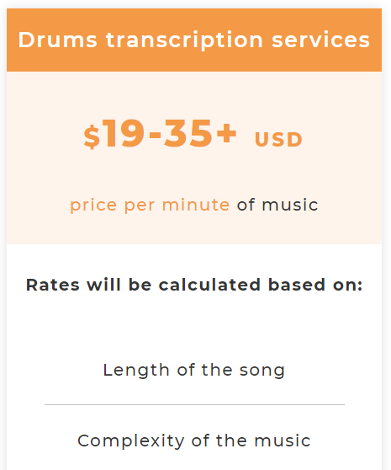
Problem
Current Transcription Services
Largely manual
Limited libraries
Focus on classical music

Slide 4

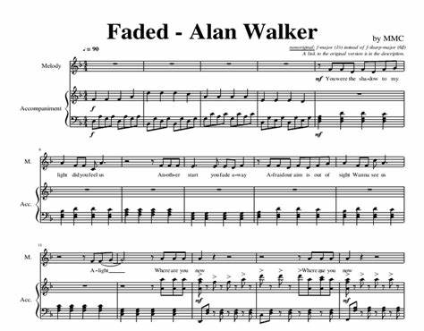
Motivation
Piano Sheet sample for Alan Walker’s Faded
People should be able to take any song they like and obtain its Sheet Music.
This ensures that they don’t have to wait for a song to get popular and get transcribed by someone on the internet.

Slide 5
Key Product Features
Handles standard issue .mp3 files (having .wav is not necessary)
Custom Encoder that allows model to be retrained with any dataset
Provides Sheet Music in simple PNG Format
Trained on pop and rock music, so it can transcribe modern music well

Slide 6
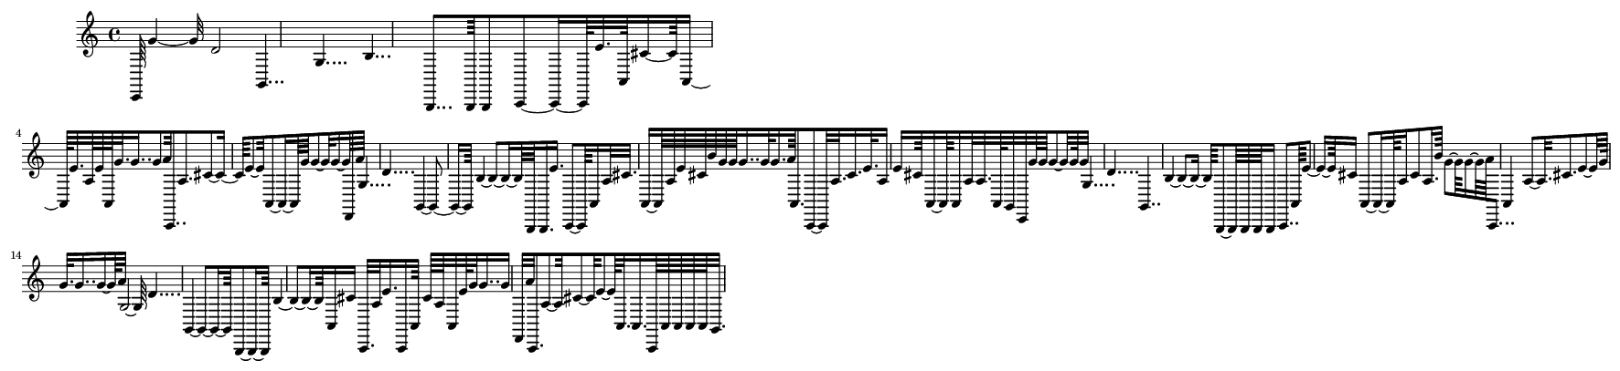

Demo
Sheet generated from Calvin Harris - My Way

Slide 7
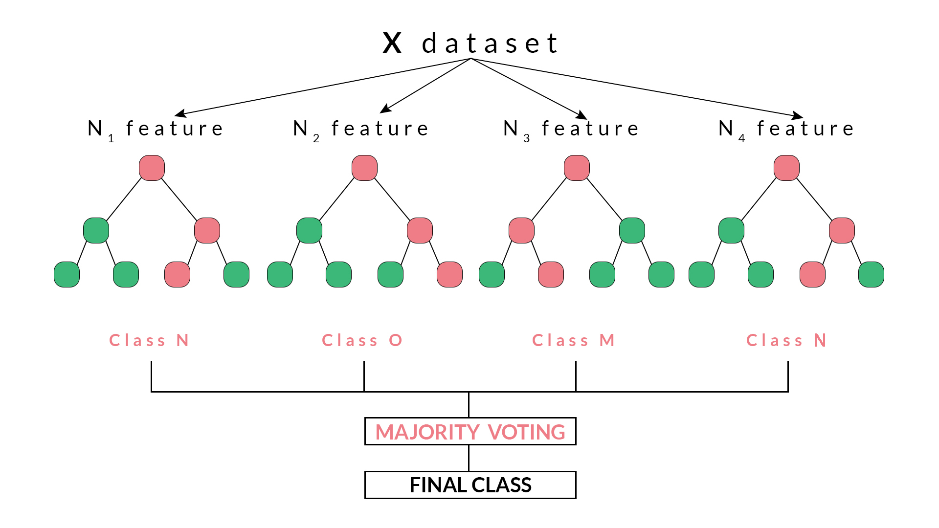
Technical Approach Summary
Model Input
Model
Model Output
MIDIs and their respective mp3s from Cprato.com
Split data into Train and Validation
Transform Audio to CQT Spectrum
Encode MIDIs as framewise One-Hot-Encoded Notes
Multi-Out Random Forest
Encoded Midi -> Decoder -> MIDI Stream -> Sheet Music (PNG)

Slide 8
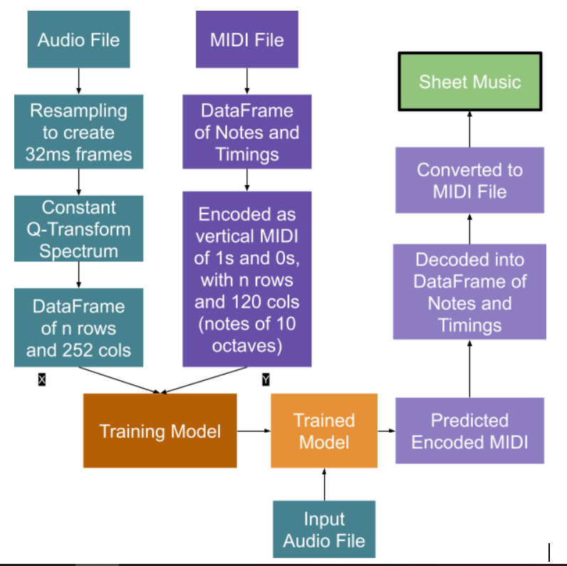
Technical Approach Summary

Slide 9
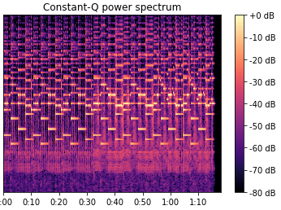
Audio Transformation and Model Input
Audio Sample
Frequency
Amplitude
Time
CQT (Constant Q-Transform) Spectrogram

Slide 10
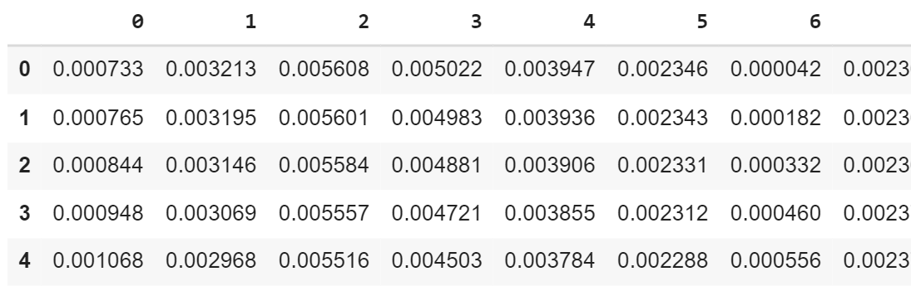
Audio Transformation and Model Input
DataFrame of 252 features and (1*60 + 18)/(0.032) = 2443 approx rows

Slide 11
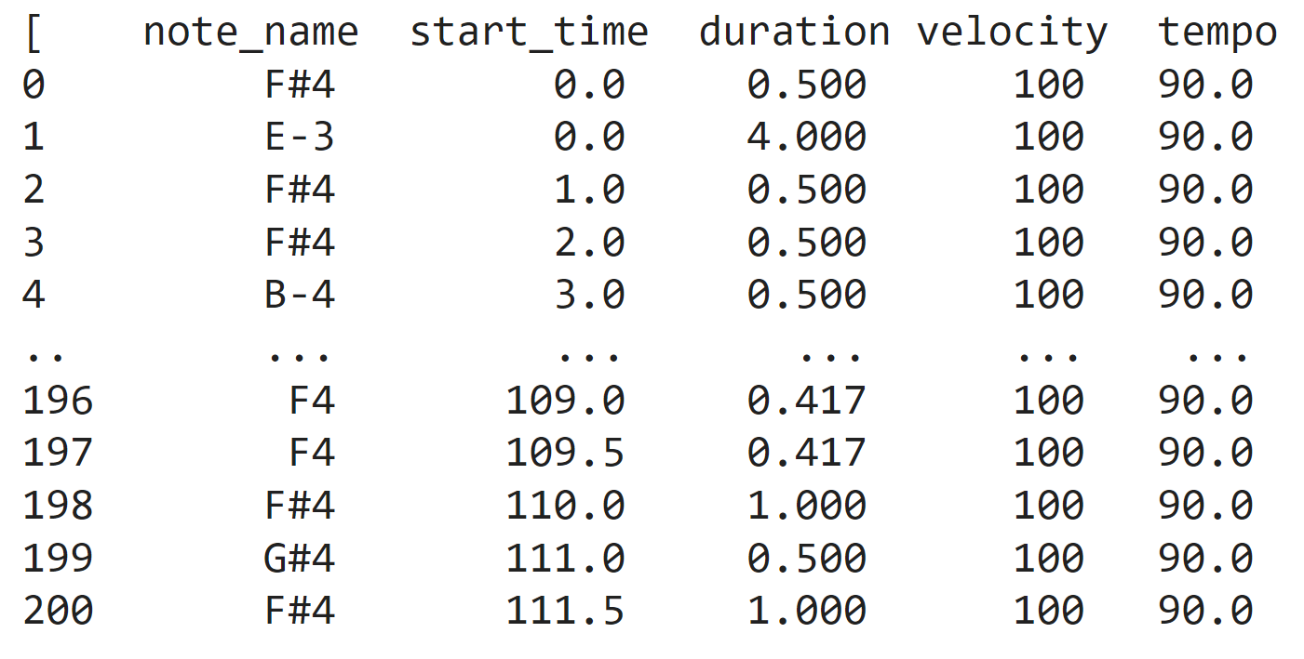
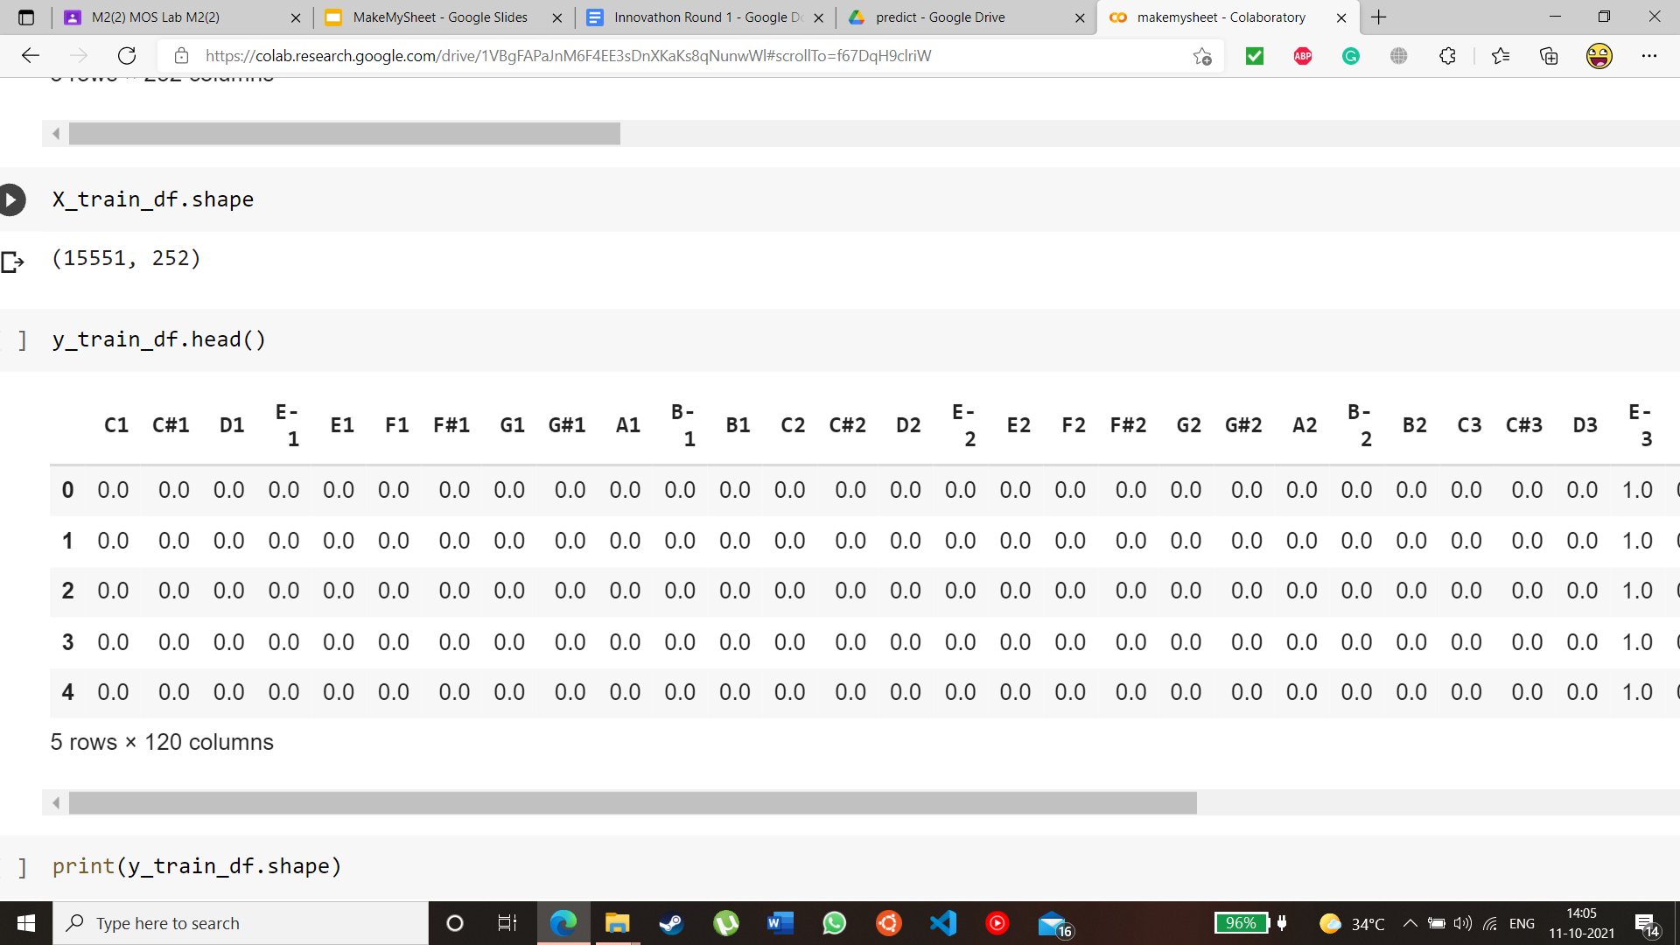
MIDI Encoding and Decoding

Slide 12
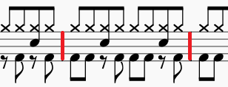
Model Output and Postprocessing
Multilabel Binary Classification output
Decoding of predictions back to MIDI Stream
Conversion of MIDI Stream into Sheet Music

Slide 13
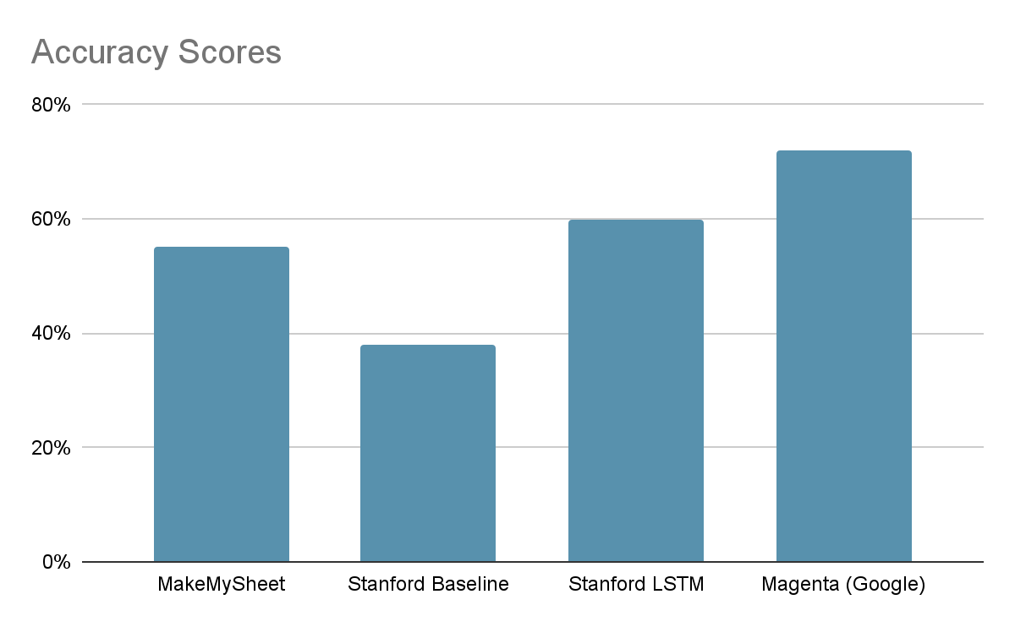
Evaluation Comparison
Although existing methods do perform better, clearly our model belongs in the same ballpark and has the ability to one day be competitive.

Slide 14
Key Takeaways
Diversity
Instead of the standard piano (MAPS and MAESTRO) datasets, we created our own Dataset from Cprato.com to train using pop, EDM and rock music.
Decision Trees
Using Random Forest models instead of LSTM makes for a much speedier prediction and training time, compensating for the long preprocessing times.
Custom Encoder
Using a “home-made” encoder and decoder, our model can be trained on any dataset, including ones without premade labels

Slide 15
Future Work
Drums
Separating drum tracks (if present) and creating separate sheet(s) for them, as they muddle the normal sheets with a lot of low notes
Reinforcement
Note Velocity
Feedback loop from user input to improve sheet music generation
Additional data points give more insight into the ‘style’ of how a note is played
Refining
Ensembles
Training on a larger and even more diverse set of data for better accuracy scores with varied music
Transcribing music requires many different tasks. With more time and resources we hope to create additional models which can infer tempo, measures, genres, note durations, etc.

Slide 16
THANKS!
ANNA-T
By Keshav Nath

